Slide 1

Set yourself up for a good year with X-ACT
Register for the X-ACademic Transition program (X-ACT), designed to help every 1st-year student develop and enhance skills for learning and coping with your academics.
This 6-week, peer-led program starts on the first full week of classes. Topics include time management, using a syllabus, study strategies, academic integrity, coping with stress, and more.
When you complete the program, you will earn an academic bonus:
five points that you can devote to a midterm exam in a participating
1-st year course of your choice. You will also be entered into a prize draw.

Slide 2
How to sign up
Check your course schedule at:
portal.stfx.ca → Banner Self-Service → Student Services → Week at a Glance
Find the list of X-ACT sections on the X-ACT Workshops Calendar.
Select one that fits your schedule, and register with your name and StFX email address.
https://stfx-success.libcal.com/calendar/xact

Slide 3
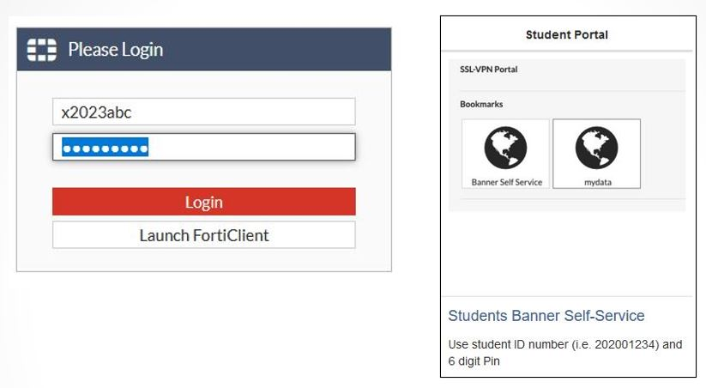
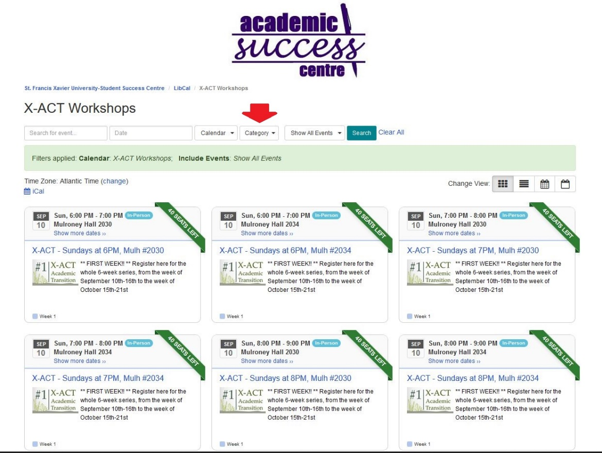
Step 1: get your
class schedule
Step 2: select your
workshop section

