Slide 1

Practicum Placements
At-a-Glance
Becky Powers
Field & Admissions Coordinator
Bachelor of Education Program

Slide 2
Practicum Placements At-a-Glance
Complete & submit your placement request form.
You will be in the same placement for both the fall & spring placement sessions.
Practicum is pass/fail.
Teaching Load
Year 1:
Fall – 25%
Spring – 50%
Year 2:
Fall – 75%
Spring – 100%
11 weeks
6 credits
11 weeks
6 credits

Slide 3
Practicum Requirements
In order to be permitted into schools you MUST submit:
We are links
Vulnerable Sector Criminal Record Check | Child Abuse Registry Check
Due August 1st Only accepted by schools if they are less than 6 months old at the start of practicum Requires a letter from the university Go to your local police detachment to complete Can complete it online Approx. $30-$50 | Due August 1st Only accepted by schools if they are less than 6 months old at the start of practicum Does not require a letter from the university Complete application online and is mailed to you No cost Takes 2-3 weeks
*Note: You will not get your placement letters if your paperwork isn’t submitted

Slide 4

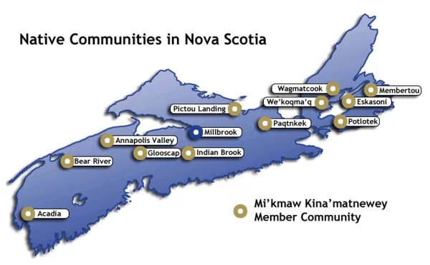
NS School Boards & Communities
You can request a placement with any of the schools in Nova Scotia (that are not private schools.

Slide 5
Bachelor of Education Handbook
Print Me!
Accessing the Handbook
St FX Bachelor of Education Website
Current Students
Handbook
I’m a link

Slide 6

Transportation
Pre-service teachers who will be living in Antigonish and teaching in Antigonish County/ Port Hawkesbury/Pictou County (including Trenton, New Glasgow, & Stellarton) have
options such as carpooling…
  with a student who has a vehicle (if that vehicle meets safety requirements).
  in a rental. St FX will rent vehicles and facilitate a meeting to help students arrange carpooling details to their respective locations. If you do not have access to your own
  vehicle.
  In either case students are
  responsible for sharing the
  cost of gas.
Handbook p.22-23
Note: This does not include students who choose to return home to teach in their own communities but is intended for those who must travel considerable distance from Antigonish to their field placements.

Slide 7
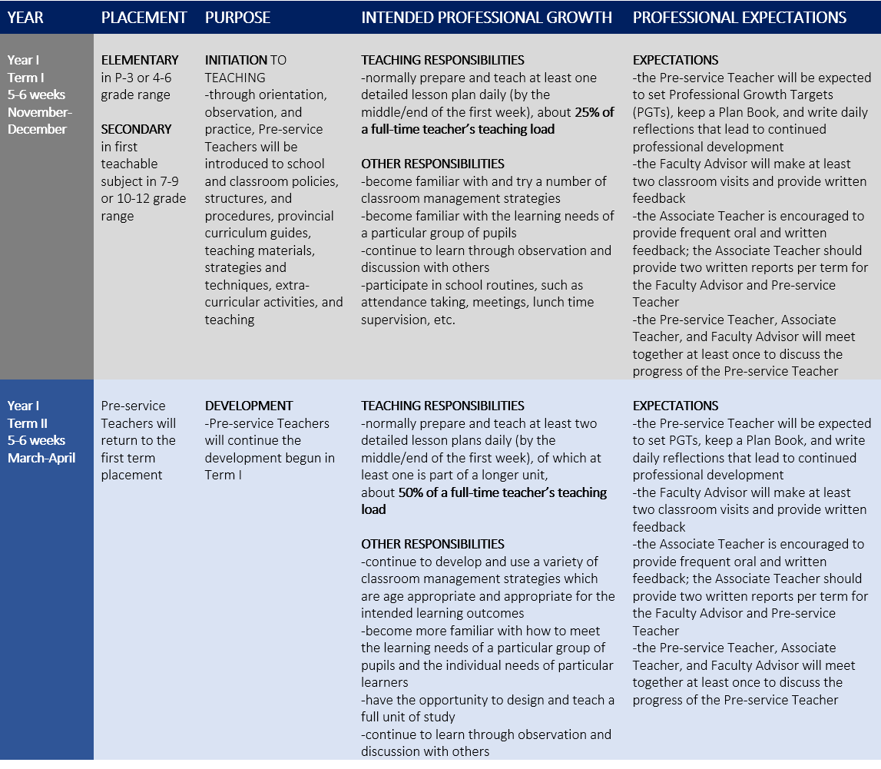
Handbook
Field Experience Professional Growth Sequence, Year 1
p.9

Slide 8

Working Together in the Field
Handbook p.21
Faculty Advisor:
Your chief contact when in the field
Could be faculty or retired educator
Will come twice to observe you in the classroom
Will meet them at “Building Bridges” (November 9th)
Associate Teacher:
A positive role model
Gives regular & supportive feedback
Promotes professional growth
Provides a written assessment
Contact point with Faculty Advisor
Pre-
Service Teacher (You)
Faculty
Advisor
Associate
Teacher
Handbook p.20

Slide 9

Alternative Placements
IWK
NS Science Centre
Antigonish Women’s Resource Centre
The Gaelic College
For out of NS or out of public school system requests
Application is reviewed by Field Committee (looking for a solid teaching component & a schedule)
Application is on p. 35 of Handbook
Due: December 15th
Autism Nova Scotia
St. Martha’s Hospital Early Intervention Program
Youth Detention Centre
Women’s Prison
Health Centre
L’Arche
Art Gallery NS
Antigonish Country Recreation
Sometimes international experiences are available (ie. Sweden, March 2023)

Slide 10
Handbook Appendices
Handbook p.35
I’m a link

