Slide 1
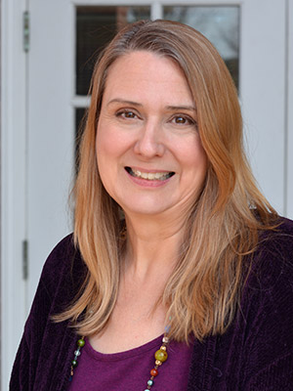

We are here to help you develop the academic skills you need to succeed:
Success @ Schwartz
Manage time
Study effectively and efficiently
Write essays and reports well
Avoid plagiarism
Work collaboratively as a team
Lindsey Arnold, Learning Skills Instructor
for Success @ Schwartz
Book an online appointment! mywco.com/stfx

